Slide 1
A Study of Cloud Properties and Rainy Cloud Prediction Model of Indian Cities using MODIS
by
Sudeshna Pahari
Registration No.: 041-1221-0369-16
Roll No.: T91/ECE/186015
Ratul Chakraborty
Registration No.: 146-1121-0352-16
Roll No.: T91/ECE/186012
Under the supervision of
Mr. Souvik Majumder

Slide 2

Certificate:

Slide 3
Acknowledgment:
Foremost we would like to thank our project guide, Mr. Souvik Majumder, Institute of Radio Physics And Electronics,University of Calcutta, who was not only a source of encouragement but also a great resource of information. We shall remain grateful to him for the immense help we have received from him for providing us all the necessary information, resources, valuable suggestions and facilities for successfully completing our project work on “A Study of Cloud Properties and Rainy Cloud Prediction Model of Indian Cities using MODIS”. We also would like to thank all our classmates, scholars and seniors of the department for their valuable suggestions and friendly cooperation extended to us which helped us in many different ways throughout the entire work.
Date: 21/06/2021
Place: Kolkata
Ratul Chakraborty and Sudeshna Pahari

Slide 4
Table of Content:
A look at Cloud Properties
Data
What is MODIS?
COD Histograms
Conclusions from COD Distributions
Scatter Plots
An Idea for a Prediction Model
Gradient Descent
Our Model
Prediction Results
Final Remarks

Slide 5
A look at Cloud Properties:
i) Cloud Top Temperature: The temperature above the cloud is called cloud top temperature. By measuring the radiation of specific wavelengths emitted from the top of a cloud, we are able to estimate the corresponding temperature according to Planck’s Law of radiation.
ii) Cloud Top Pressure: Cloud top pressure can be considered equivalent to cloud top height above mean sea level.
iii) Cloud Optical Depth: In Physics COD is the natural logarithm of the ratio of incident to transmitted radiant power through a material.
iv) Cloud Water Particle Effective Radius: Cloud water particle effective radius is a weighted mean of the size distribution of cloud water droplets.
v) Cloud Ice Particle Effective Radius: Cloud ice particle effective radius is a weighted mean of the size distribution of cloud ice droplets.

Slide 6
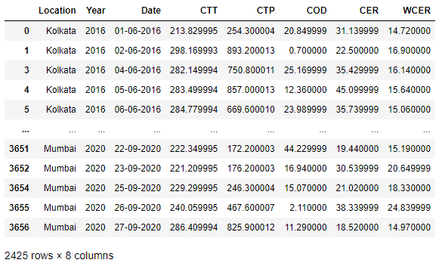
Data:
The cloud properties data used in this study were collected individually from Level-3 MODIS Atmosphere Daily Global Products for different Indian Cities (MOD08_D3 and MYD08_D3; note that the prefixes ‘‘MOD’’ and ‘‘MYD’’ are used for products based on MODIS measurements onboard Terra and Aqua platforms, respectively). All the data were put together, labelled, cleaned and made into a workable dataset.
Cities used in this study were Kolkata, Mumbai, Hyderabad, Delhi, Chennai and Bangalore.
The data was downloaded for the Indian monsoon season (June-September) for the years 2016-2021.
Two datasets were made. One for training (2016-2020) and one for testing(2021). The training set was used for most of the plots in the study.
A slice of the dataset is shown here:

Slide 7
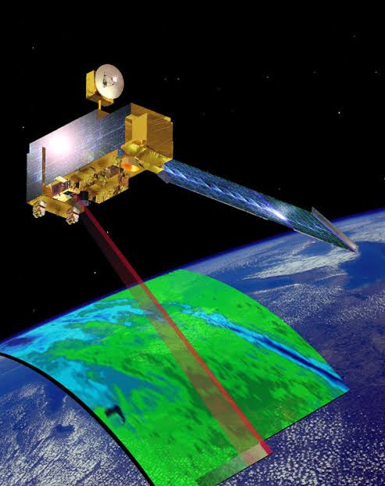
What is MODIS?
MODIS (or Moderate Resolution Imaging Spectroradiometer) is a key instrument aboard the Terra (EOS AM) and Aqua (EOS PM) satellites. MODIS is an extensive program using sensors on two satellites that each provide complete daily coverage of the earth. The data have a variety of resolutions; spectral, spatial and temporal.
Terra's orbit around the Earth is timed so that it passes from north to south across the equator in the morning, while Aqua passes south to north over the equator in the afternoon. Terra MODIS and Aqua MODIS view the entire Earth's surface every 2 days, acquiring data in 36 spectral bands

Slide 8
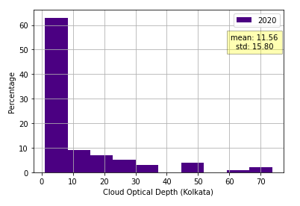
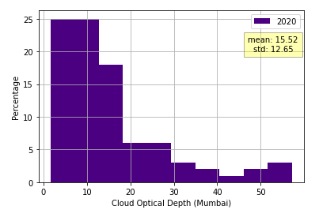
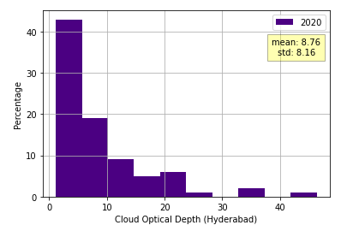
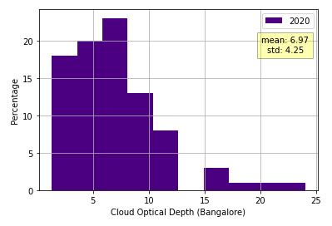
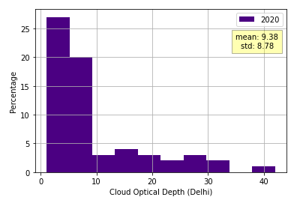
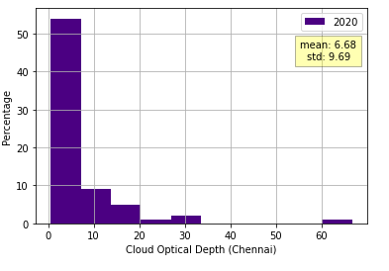
COD Histograms (For Terra):

Slide 9
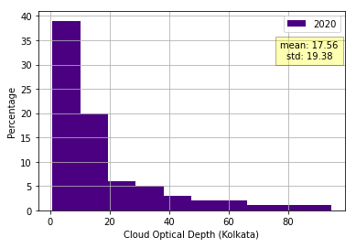
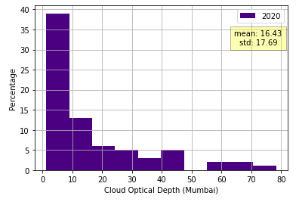
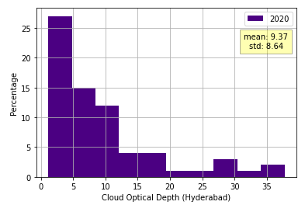
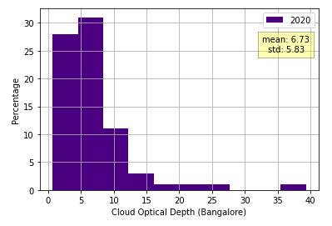
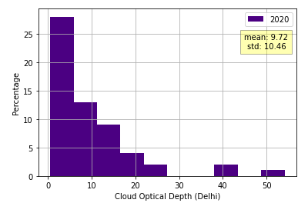
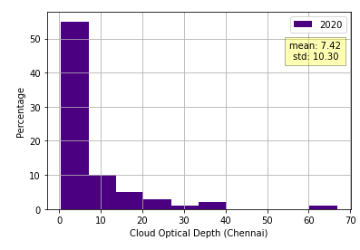
COD Histograms (For Aqua):

Slide 10
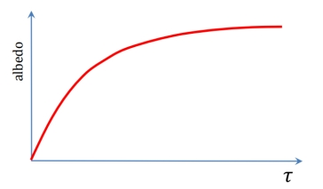
Analysis of COD Distributions:
1. From the histograms we get the following comparison table of COD values :
2. According to Indian Journal of Physics the places where industrial activities take place vividly, pollution occurs and the COD values of those respective places also increase significantly. Because according to Twomey’s effect (Pollution and The Planetary Albedo, Sean Twomey) pollution increases the albedo and also Albedo increases with optical thickness. Below is the concave inclination relationship between Albedo and COD –
LOCATION | AQUA |  |  | TERRA
 | PEAK | STD | MEAN | PEAK | STD | MEAN
Delhi | 0-7 | 10.46 | 9.72 | 0-5 | 8.78 | 9.38
Mumbai | 0-10 | 17.69 | 16.43 | 0-12 | 12.65 | 15.52
Kolkata | 0-10 | 15.8 | 11.56 | 0-20 | 19.38 | 17.56
Hyderabad | 0-5 | 8.64 | 9.37 | 0-5 | 8.16 | 8.76
Bangalore | 5-7 | 5.83 | 6.73 | 7-9 | 4.25 | 6.79
Chennai | 0-9 | 10.3 | 7.42 | 0-9 | 9.69 | 6.68
We can infer from the above table that in tropical regions like Kolkata, Mumbai and Delhi the mean COD values are more compared to the southern regions.
Also from Gettelman Et Al. 2002; Liu Et Al. 2007 we get the information that the tropics and extratropical regions are the active regions for DCC formation.
Hence we get an affirmation about our observation.
Also in the regions near to the Equator the COD values are less compared to the regions nearer to the Tropic of Cancer.
Also from CPCB’s statistics (The Hindustan Times,Nov. 23,2021) and IQAir it is evident that Kolkata and Mumbai along with Delhi NCR are the most polluted cities. Hence we infer from our observation that in the tropical region where we have achieved greater COD values are more sensitive towards pollution.

Slide 11
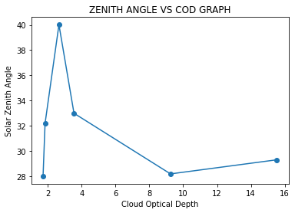
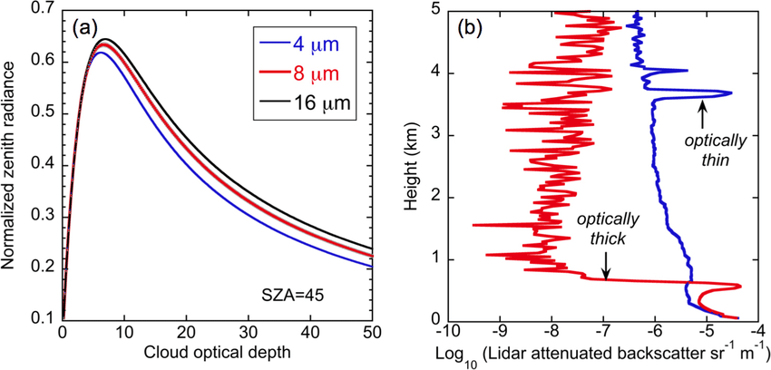
3. We have found that cloud optical thickness has an effect on Zenith position. As Zenith position may shift throughout the year depending on the cloudiness, ozone content and water vapour we can find a non linear relationship between the Zenith position and COD. We have taken the combined COD data of year 2020, 1st June from MODIS. Also we have calculated the SZA or solar Zenith angle of the same date and year at 2.30 pm. We have taken the information that Indian Standard Time is calculated from the clock tower in Mirzapur nearly exactly on the reference longitude of IST at 81°44'E, within 4 angular minutes.
Calculations :
vFor Delhi: From given data, n= day of the year counted from 1st January = 152 Angle of declination, δ = 23.45 × Sin[(360/365) × (284+n)]° = 23.45 × Sin[(360/365) × (284+152)]° = 23.44 B = (360/364) × (n-1) = (360/364) × (152-1) = 149.38 Equation of time or E = (9.87Sin2B-7.53CosB-1.5SinB) min = -2.947 min LST or local solar time = 2:30 hrs ± 4 × (L_{sat} – L_{loc}) (min) + E = 2:30 hrs ± 4 × (L_{sat} – L_{loc}) (min) – 2.947 = 2:8:47.22 Hour angle, ω = (12:00 - LST) hrs × 15° = -32.19° Cosθ_{z} = Cos(28.7) Cos(23.44) Cos(-32.19) + Sin(23.44)Sin(28.7) = 0.8720 Therefore, Zenith angle θ_{z} = Cos⁻¹(0.8720) = 29.30°
Hence we have plotted the graph of SZA vs COD using Matplotlib.
We have so far got the same plot from The interdependence of continental warm cloud properties derived from unexploited solar background signals in ground-based lidar measurements by Chiu, J. C.; Holmes, J. A.; Hogan, R. J. and O’Connor, E. J. (2014).
We have calculated the respective Zenith angles using the above method. Here is our results:
Location | SZA in degrees | COD
Mumbai | 28.18 | 9.249
Delhi | 29.30 | 15.54
Hyderabad | 32.2 | 1.83
Bangalore | 32.99 | 3.54
Chennai | 28.02 | 1.71
Kolkata | 40.02 | 2.65
Hence we can infer our observation with an analogy to the actual plot.

Slide 12
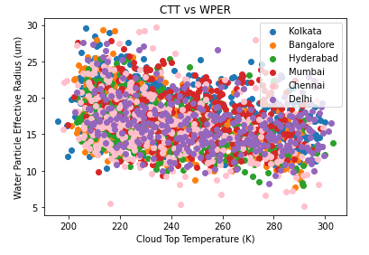
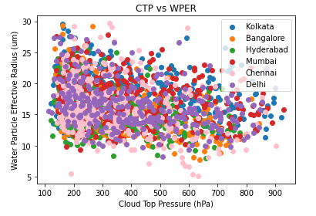
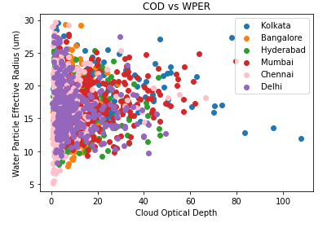
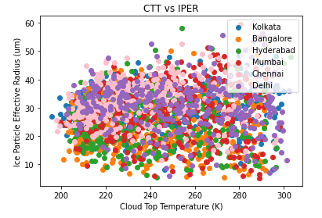
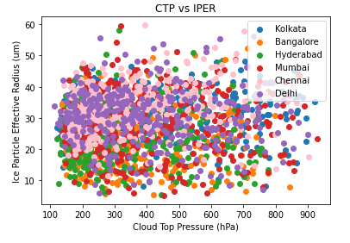
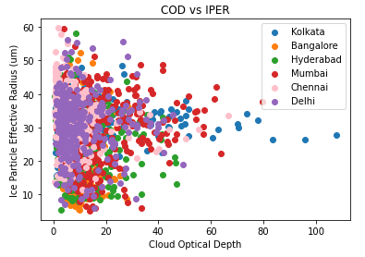
Scatter Plots:

Slide 13
The Idea for a Prediction Model:
As we can see from the scatter plots, CTT, CTP and COD are somewhat related to Water Particle Effective Radius(WPER).
Now clouds with WPER>= 20 are considered to be Rainy Clouds.
So, we can try using CTT, CTP and COD to predict the value of WPER and hence, see if a cloud is Rainy or not.
We will use a linear approach to this problem. We will assume the relation between WPER and the others to be as:
y = m₁x₁ + m₂x₂ + m₃x₃ + b
where y is the WPER, x₁, x₂ and x₃ are CTT, CTP and COD respectively. m₁, m₂ and m₃ are co-efficeints and b is the intercept.
We will use our training dataset(2016-2020) to calculate m₁, m₂, m₃ and b using the Gradient Descent algorithm. Then we will use the obtained values to calculate the WPER of the testing dataset(2021) and compare it with the already known WPER of the testing dataset.

Slide 14


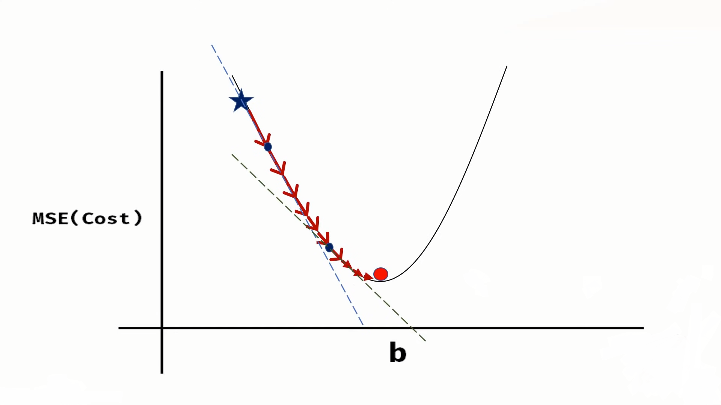



Gradient Descent:
Gradient Descent is an algorithm that finds the best fit line for the given training data set. The main purpose of this algorithm is to reduce the cost function to the lowest possible and hence find the coefficients as shown in the figure 1:
The cost function is nothing but the mean square error which is defined as,
Now, to get the lowest cost function we need to start with some values of m and b and get to a desired value where cost function is lowest. How to get the consecutive values of m and b, can be better explained by a 2D representation of the previous figure (figure 2):
Here, we can see that after starting with some value of b, to get the next value we need the slope of the graph at that point which is nothing but the partial derivative of the cost function with respect to b. so,
Now that we have the slope and hence a direction to where the next value of b will be. So now we need to take a step and the b value will be as the equation,
Same equations can be found for m,
Here learning rate is the amount of step taken and is found by trial and error and is dependent on the dataset. These steps are repeated and eventually, we get the desired values of m and b.

Slide 15
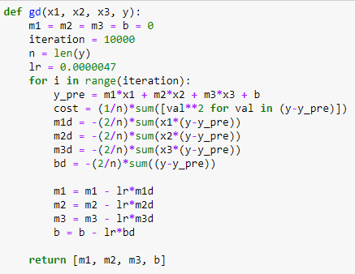
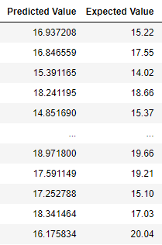
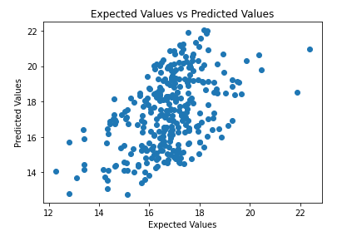


Our Model:
We use the gradient descent algorithm on our training dataset to get the coefficients of CTT, CTP and COD against WPER. The code for the algorithm is shown on the side here.
After running the algorithm for our dataset the values we got are,
m1 = 0.08763528698364664
m2 = -0.013543220481943227
m3 = 0.026571230454651446
b = 0.016564501371274083
where, m₁, m₂ and m₃ are coefficients of CTT, CTP and COD respectively and b is the intercept.
We take these values and put them in the linear equation, y = m₁x₁ + m₂x₂ + m₃x₃ + b
Then use the known values of x₁, x₂ and x₃ of the test dataset(2021) to calculate the values of WPER of 2021. Then we compare the obtained values with known values.
The predicted values we got have an RMS error of 1.93um and a correlation coefficient of 0.48

Slide 16
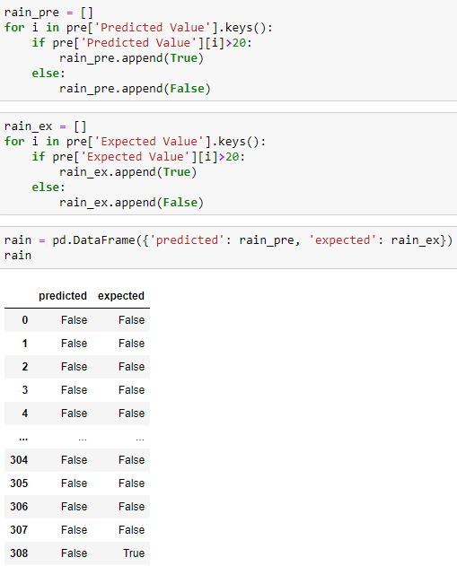
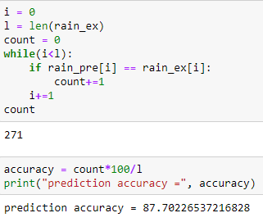
Prediction Results:
Since we have the predicted values of WPER, we can start with our prediction of rainy clouds. As said before, rainy clouds are defined as clouds with WPER>= 20.
So, we can take our previous data table of predicted and expected values and run them through a condition on whether they are >=20 or not. We can put True if is >=20 and False if not. By doing this we got a table like this.
Now that we have this table, all we have to do is to compare if the predicted result is equal to the expected result and calculate the accuracy. After comparing, as shown here, we have obtained an accuracy of 87.7.
This concludes our prediction results.

Slide 17
Final Remarks:
In our study we have found that
The mean COD values in tropical regions are more compared to the southern regions.
the tropical region where we have achieved greater COD values are more sensitive towards pollution.
There is a non-linear relationship between the Solar Zenith Angle and COD.
We can calculate WPER from other properties of cloud and predict rainy clouds to a certain degree of accuracy.
In our future work we would like to
Explore the seasonal variabilities of COD.
Verify our findings with other countries.
Find a better algorithm to predict WPER values.

Slide 18
References:
Tianle Yuan and Zhanqing Li (2010) “General Macro- and Microphysical Properties of Deep Convective Clouds as Observed by MODIS”
Albrecht, B. A., C. W. Fairall, D. W. Thomson, A. B. White, J. B. Snider, and W. H. Schubert (1990): Surface-based remote sensing of the observed and the adiabatic liquid water content of stratocumulus clouds. Geophys. Res. Lett., 17 , 89–92
Baum, B. A., D. P. Kratz, P. Yang, S. C. Ou, Y. X. Hu, P. F. Soulen, and S. C. Tsay, 2000: Remote sensing of cloud properties using MODIS airborne simulator imagery during SUCCESS 1. Data and models. J. Geophys. Res., 1
Bruce A. Albrecht,Christopher W. Fairall,Dennis W. Thomson,Allen B. White,Jack B. Snider,Wayne H. Schubert 1990 “Surface-based remote sensing of the observed and the Adiabatic liquid water content of stratocumulus clouds”
Twomey, S., 1974: Pollution and the Planetary Albedo. Atmospheric Environment
The interdependence of continental warm cloud properties derived from unexploited solar background signals in ground-based lidar measurements by Chiu, J. C.; Holmes, J. A.; Hogan, R. J. and O’Connor, E. J. (2014)

Slide 19
Thank You

